Slide 1
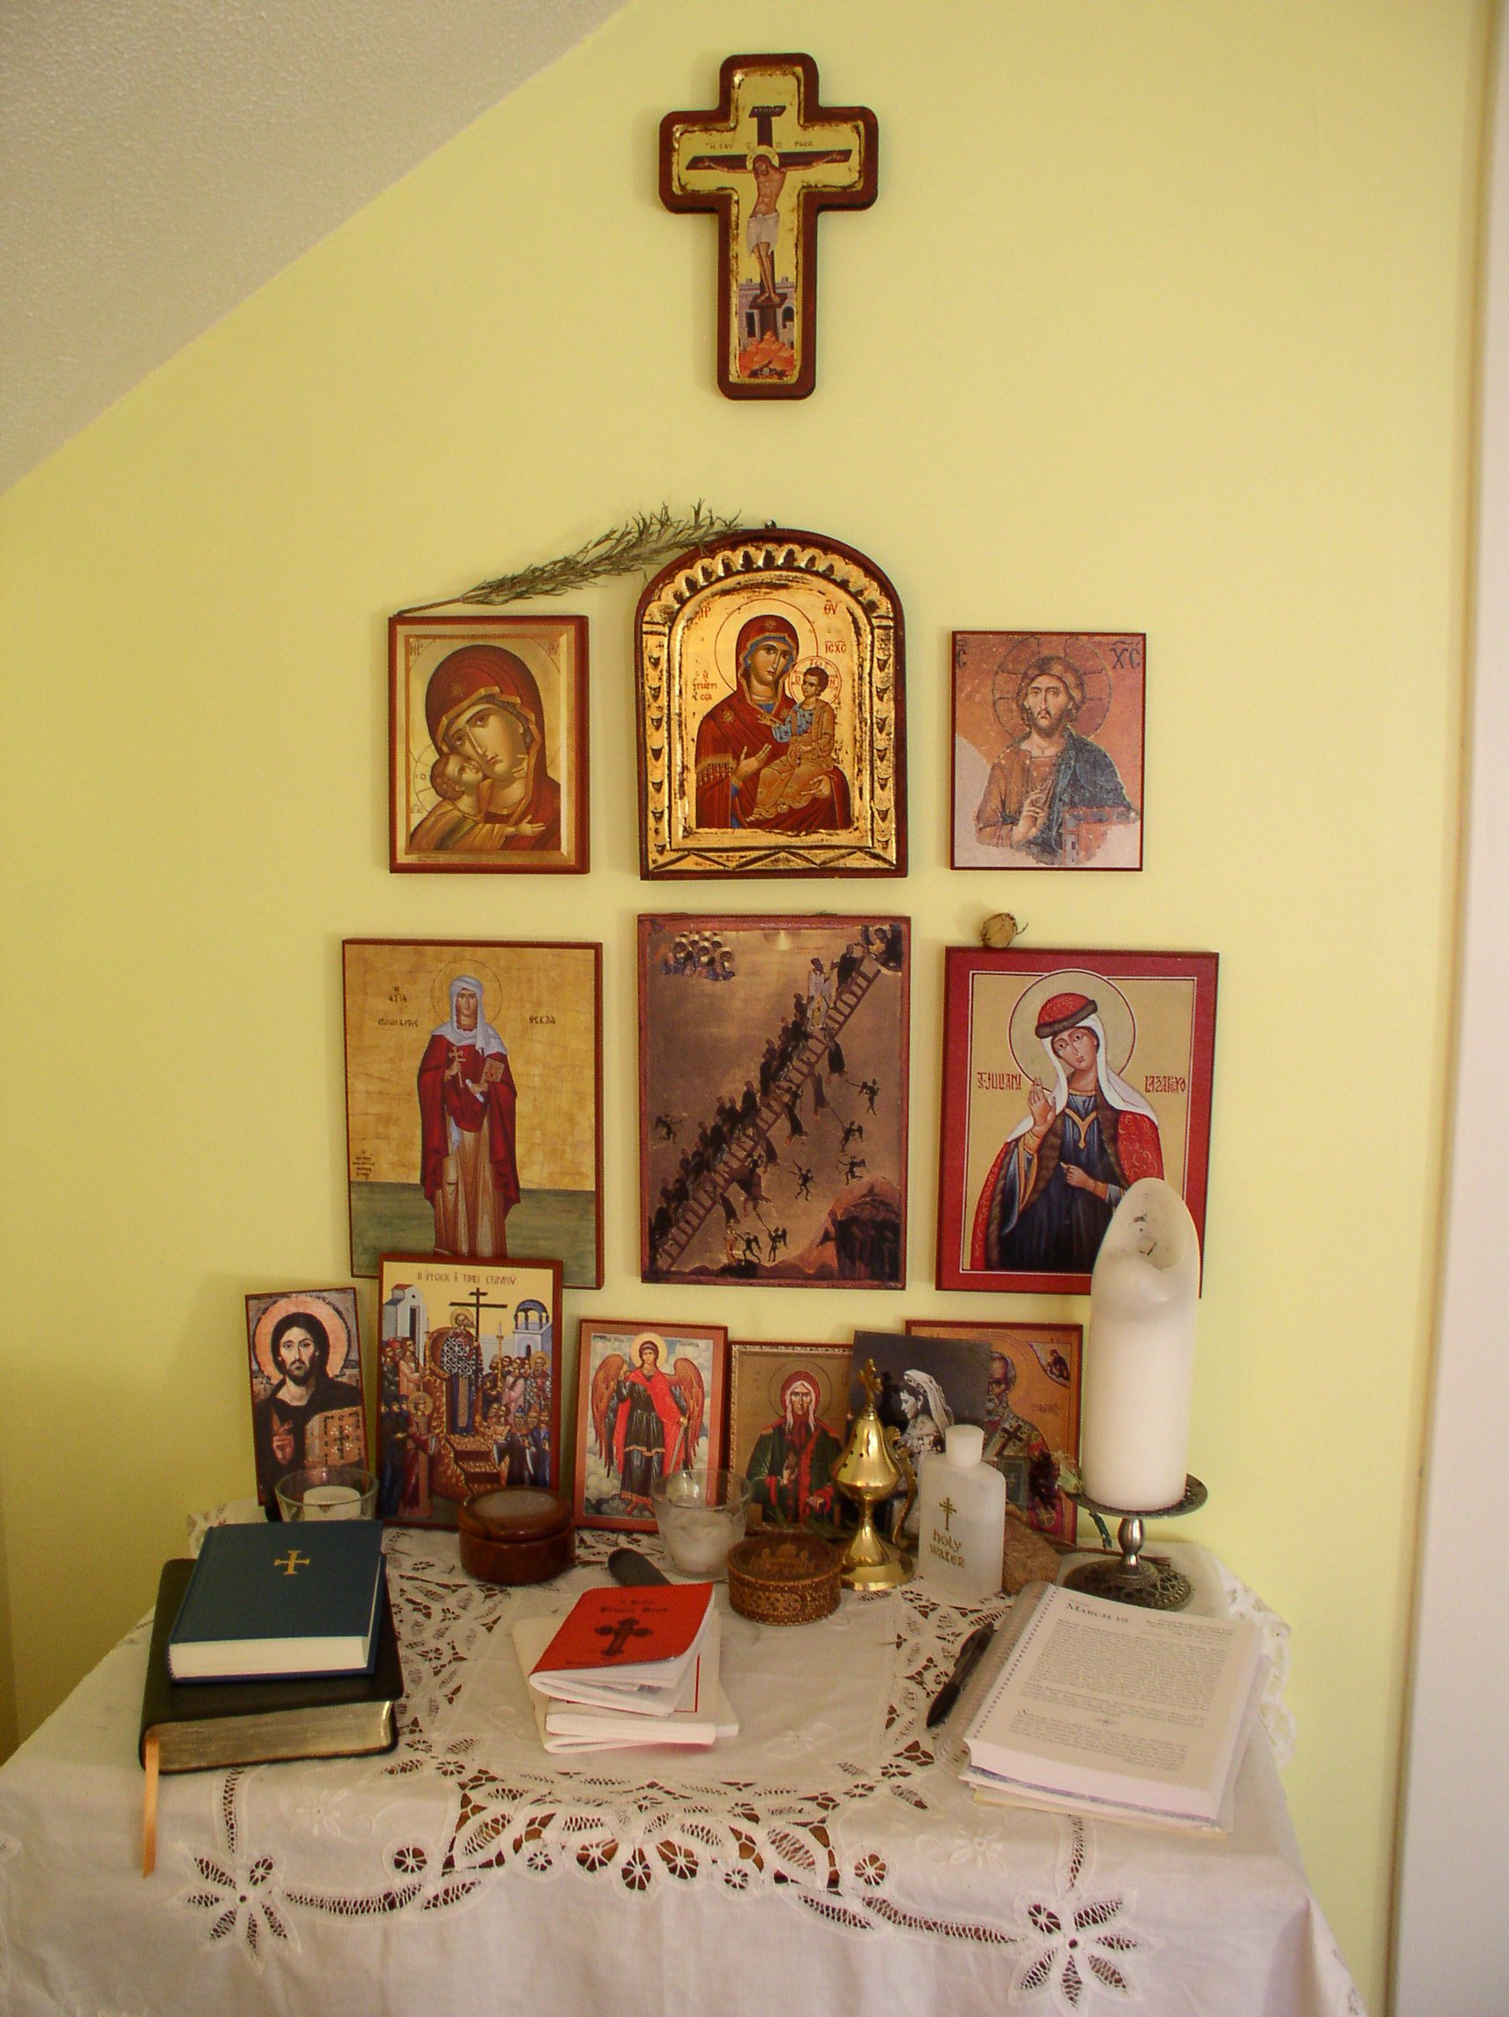
Building an Icon Corner

Slide 2
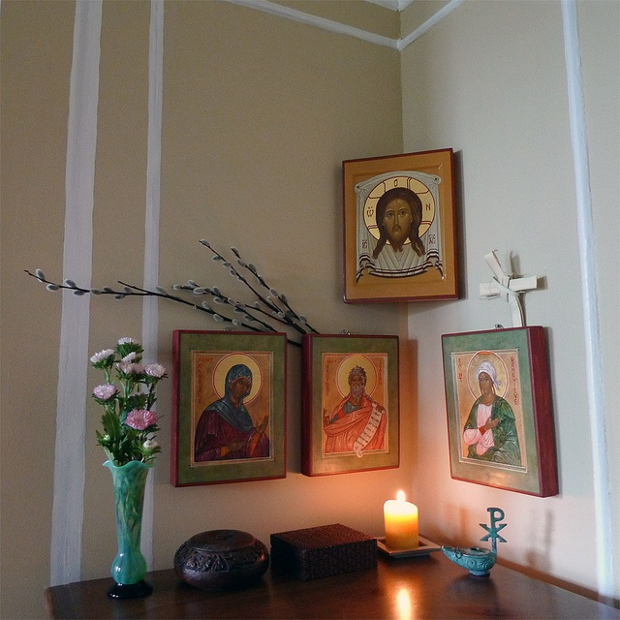

Slide 3
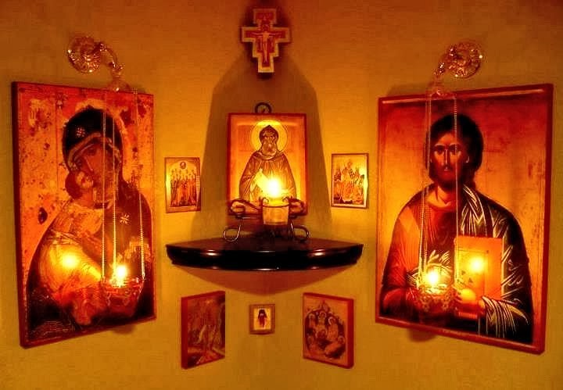

Slide 4
What is an icon corner?
An icon corner is the family's place of worship, also called the home altar.

Slide 5
The Spiritual Heart of the Home
The icon corner becomes the spiritual heart of the home–a constant reminder to pray, a connection between the family and the greater family of saints who have gone before.

Slide 6
History
The concept of the Church of the Home is an ancient Orthodox tradition, beginning in the first century. At this time, because of the persecutions, there were no separate churches, so Christians would gather in private homes to worship.

Slide 7
Location
Icon corners are typically located in the north- or south-east corner of a room, or on an east-facing wall of the house, since East is the traditional direction for Orthodox prayer.

Slide 8
Prominent in the House
The icon corner should also be in a place that is visible to all of the family and easily accessible. It should be an integral part of the daily life of the household.

Slide 9
What do I include in my icon corner?
Icons of Christ and the Theotokos.
Icons of the family saints: Each Orthodox Christian is given a saint’s name and maintains a special relationship with that saint throughout their lives. Therefore, it makes sense to have that saint’s icon in your icon corner.
Icon of the current feast, together with other festal icons (icons of the Nativity of Christ, the Crucifixion, the Ascension, etc.) We place the current festal icon in a prominent location.

Slide 10
Icon Corner Contents (1)
Candles: Orthodox Christians light candles when they pray as a reminder that Christ is the Light of the world. If you had any candles blessed during the Feast of the Presentation of the Lord, then those candles should be in your icon corner.
Holy Water: Orthodox Christians receive holy water during the Feast of Theophany (the baptism of Christ). That holy water should be kept in the icon corner. We drink holy water and receive Christ’s blessing when we are sick, before a journey, or simply at the beginning of the day with morning prayers.

Slide 11
Icon Corner Contents (2)
Palm Branches: In the Orthodox Church, we hold palm branches during Liturgy on the Feast of the Entrance of Our Lord into Jerusalem (Palm Sunday). These palms are blessed with holy water and kept in the icon corner until the next Palm Sunday.

Slide 12
Icon Corner Contents (3)
Incense: Orthodox Christians pray during Vespers, “Let my prayer arise, before you like incense.” Incense is used nearly continuously during Liturgy and other times of worship. It can also be used during family prayers at home. You can purchase incense and a censer from your church’s bookstore, from Ancient Faith publishing, or from Amazon.
Prayer Lists: Many families make a list of people that they want to pray for each day. They may add names of friends, family, or church members who are sick, newly married or baptised, or who have recently departed.

Slide 13
Icon Corner Contents (4)
Prayer Books: Prayer books help us pray the prayers of the Church at home. They are great for helping us learn the Trisagion prayers, the Morning and Evening prayers, and prayers for special occasions. There are also prayer books for specific prayers, such as the Akathist Hymn, which can add a beautiful depth to our prayer life.

