Slide 1
Church Design

Slide 2
Introduction
An Orthodox church as a church building of Eastern Orthodoxy has a distinct, recognizable family of styles among church architectures. It is influenced by the legacy of the Eastern Roman Empire and Byzantine architecture.

Slide 3
The Cathedral of Saint Sava in Belgrade

Slide 4
Church of the Intercession on the Nerl (1165), one of the most famous Russian medieval churches.

Slide 5
St Andrew of Patras Greek Orthodox Cathedral in Patras, Greece

Slide 6
What is the church cupola ?
The cupola is a rounded dome forming a roof or ceiling of the church. (revisit the previous 3 slides).
The cupola instead of a flat ceiling symbolizes the sky.
Sometimes crosses have a crescent-like shape at the bottom so that the shape resembles an anchor, which symbolizes hope for salvation.

Slide 7
Orthodox church buildings have the following basic shapes, each with its own symbolism:
• Elongated: rectangle, rounded rectangle (oval), symbolizing the ship as a means of salvation (Noah's Ark)
• Cruciform (cross shaped)
• Star shaped
• Circular

Slide 8
The Church building
The Church building is divided into three main parts: the narthex, the nave (the temple proper) and the sanctuary (also called the altar or holy place).

Slide 9
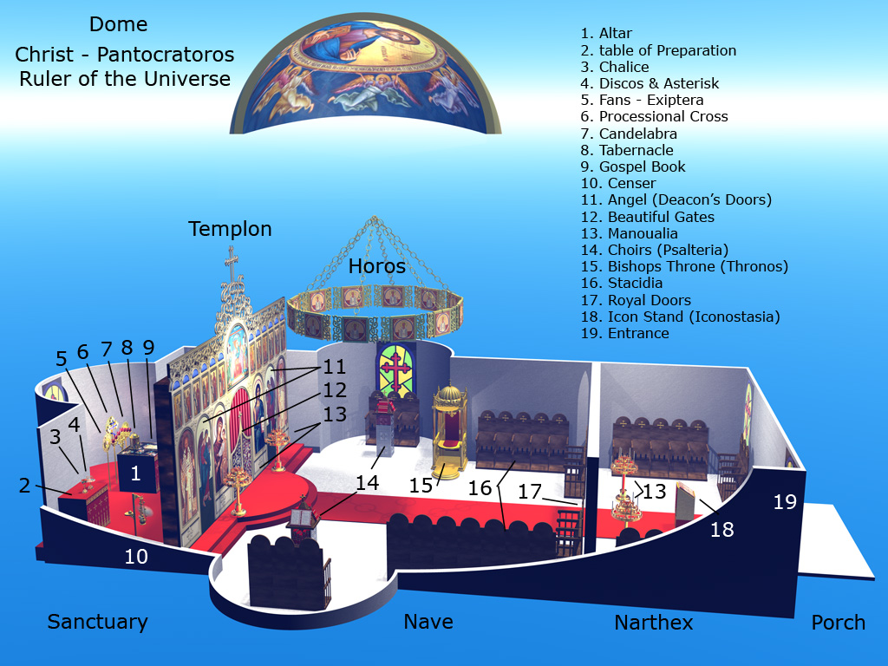
An illustrated layout of the traditional interior of an Orthodox Church

